Slide 1
UCD Assignment
Made by Mariyana, class CB-01

Slide 2
Future in ucd field
I want to be a UI Developer because I enjoy the challenge of designing user interfaces that are both intuitive and visually appealing. I am very interested in the intersection of design and technology, and I enjoy coming up with creative solutions to complex design problems. Working as a UI Developer allows me to combine my technical skills with my passion for design, resulting in a rewarding and exciting career path.

Slide 3
“gOOD” WEBSITES

Slide 4
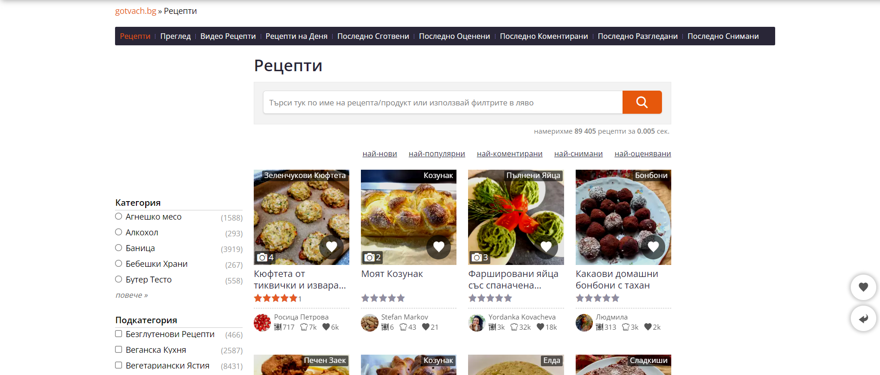
gotvach.bg
Gotvach.bg is a well-organized website. You can easily find what you are looking for as well as it is very informative and user-friendly

Slide 5
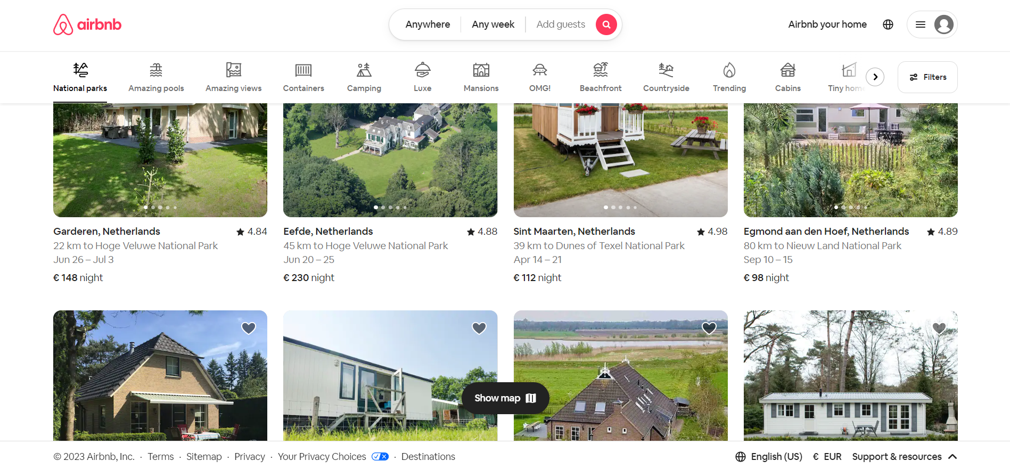
Airbnb.com
Airbnb's website is well-designed and simple to navigate, with clear calls to action. With beautiful images and detailed descriptions of each listing, the website makes it simple to find and book unique accommodations.

Slide 6
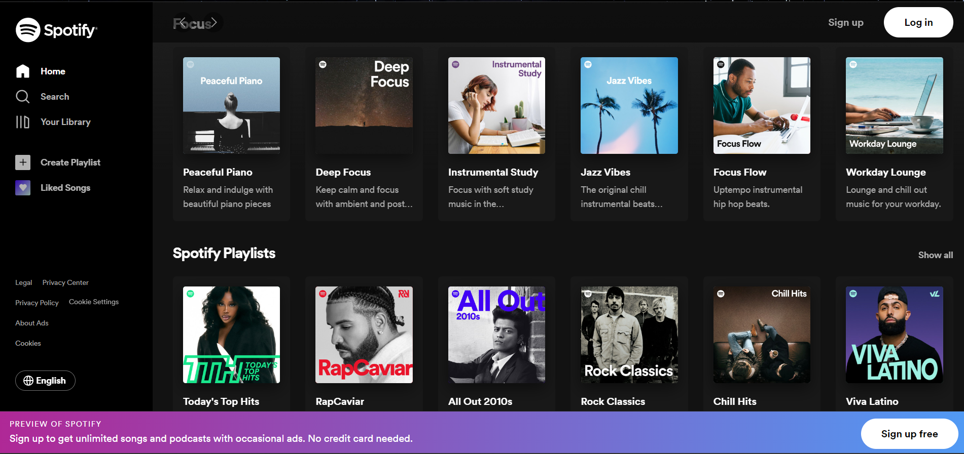
Spotify.com
I think that Spotify's website is simple, modern, and user-friendly, with simple navigation and controls.

Slide 7
“BAD” WEBSITES

Slide 8
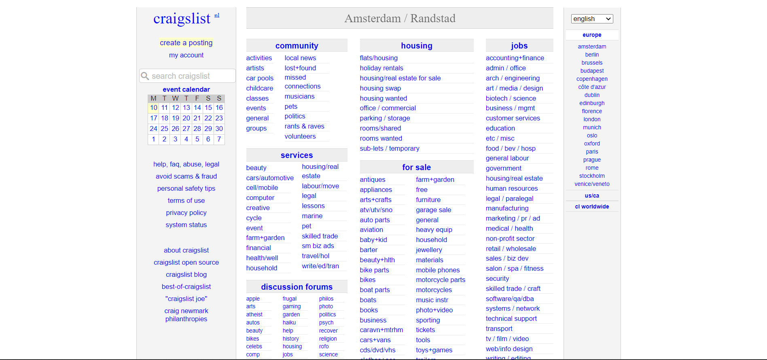
CRAIGsLIST.org
Craigslist is difficult website to navigate through. The website lacks any type of modern styling as well as it its filled with spam or scam advertisements

Slide 9
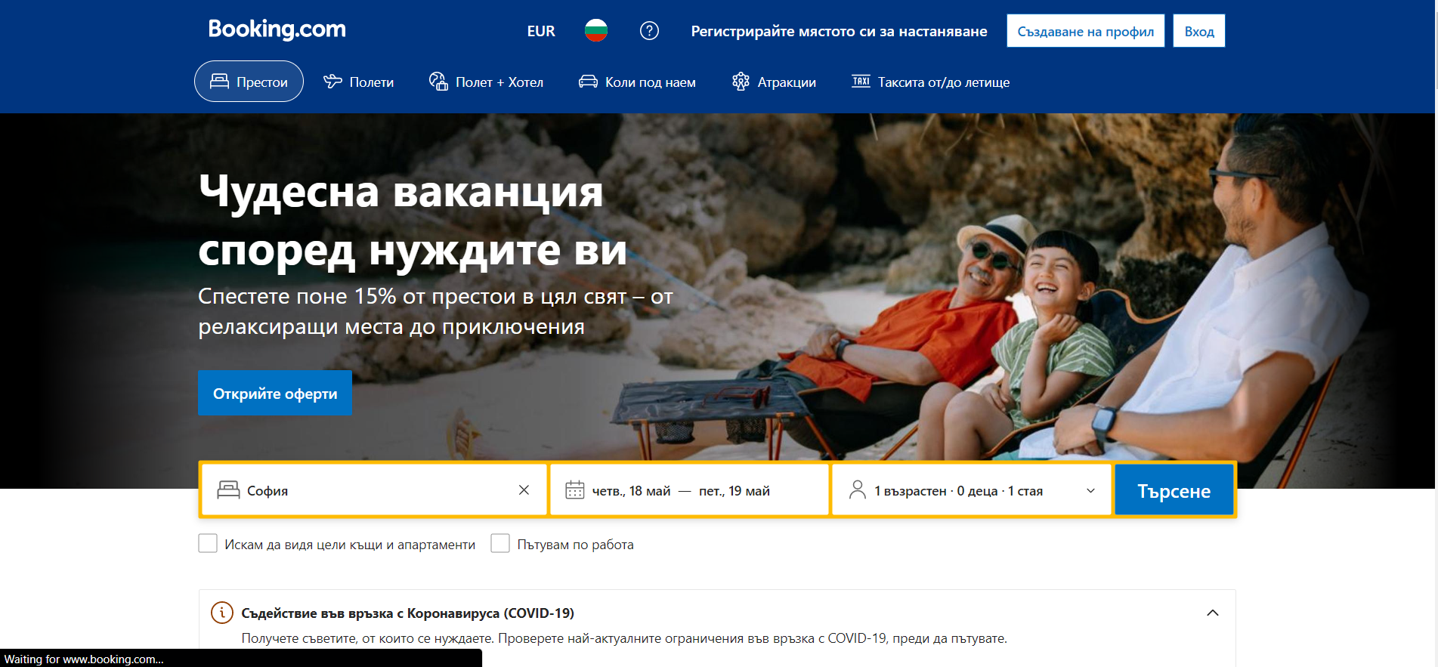
booking.com
Booking.com is not a bad looking website, though I dislike it because of all inaccurate information displayed there such as hotel availability and pricing.

Slide 10
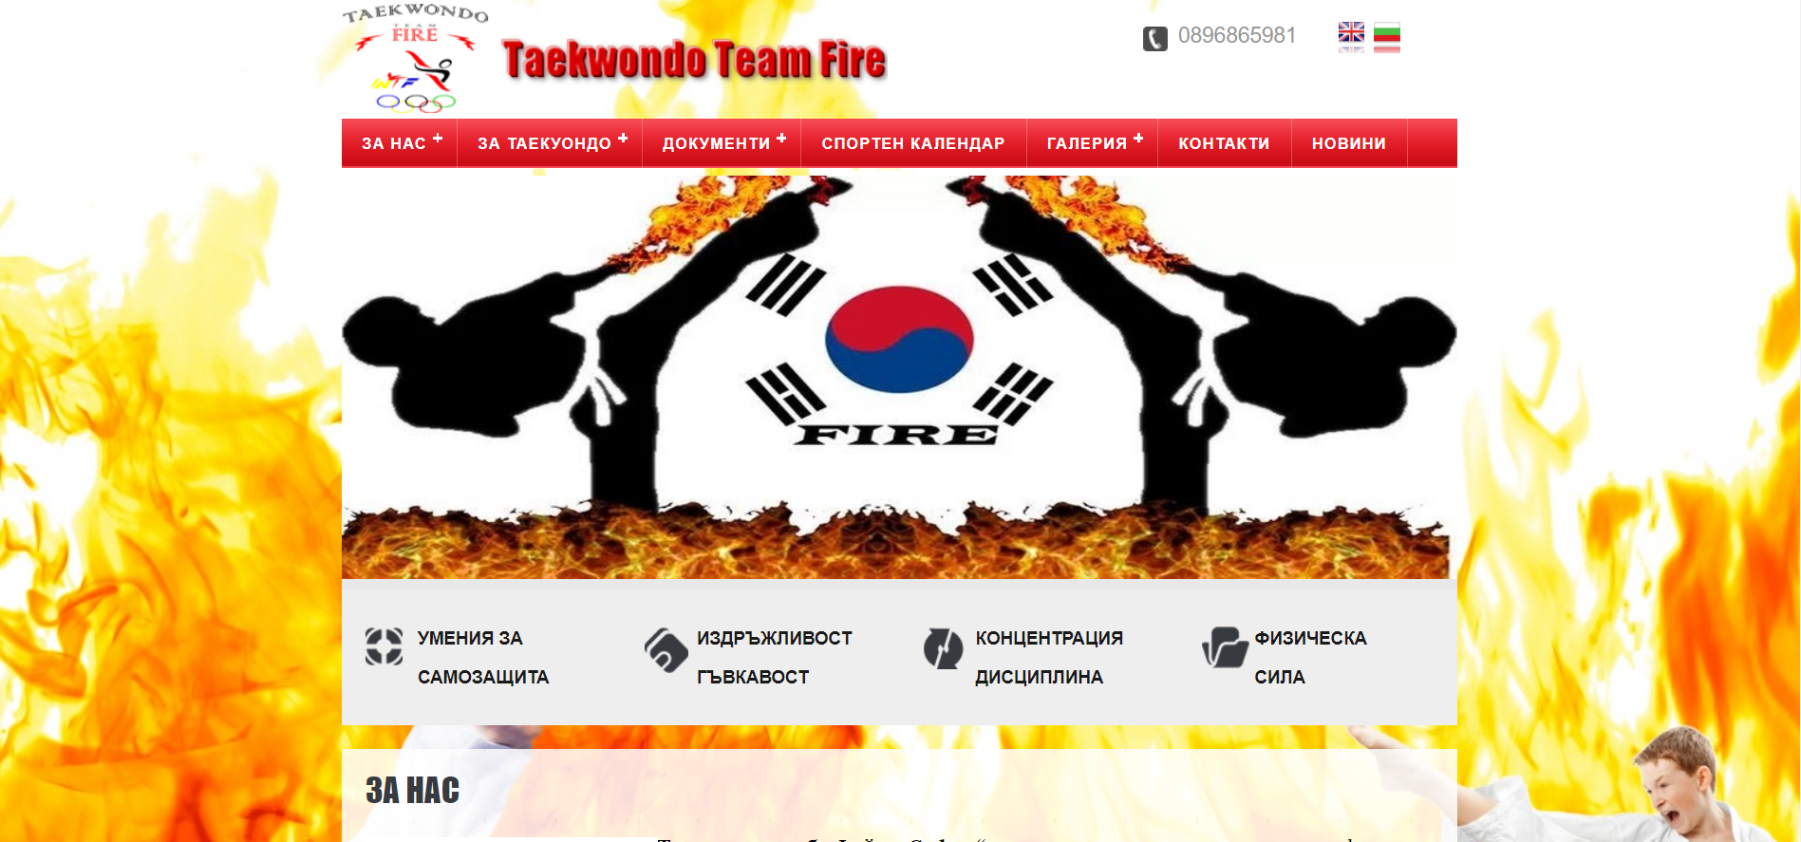
firetkd.net
The reason I think firetkd.net is a bad website is mainly because of the basic style and bright colors that this website has.

Slide 11
THANK YOU
Mariyana Mileva, CB-01

